Slide 1

Fiscal Year 2022 Fall BUDGET:
HIGH SCHOOL zoom session
Demonstration on Preparing a Budget
Budget and Analysis Department
Kenia Tiznado
September 17, 2021

Slide 2
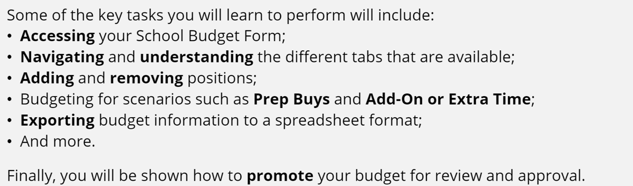

Objectives
Balance a School Budget
Tips & Tricks
Navigating & Understanding
Notes:
Balance a budget using the videos and guide on training website
Tips & Tricks – comma separator, alias display

Slide 3
Resources
Strategic Budget
Strategicbudget.ccsd.net
Zoom Sessions Playback
Training.ccsd.net
Additional Documents & Resources
Training.ccsd.net
School Budget Assistance Schedule in ELMS
Learn.ccsd.net
Step by Step Guides
Training.ccsd.net
HCM Rights Request Form
Support.ccsd.net
Notes:
TRAINING.CCSD.NET > RESOURCES > MANUALS & DOCUMENTS > SCROLL TO THE BOTTOM
HCM Rights Request Form – 2 users for ES & MS, 3 users for HS. support.ccsd.net > Forms

Slide 4

Tips & Things to Know
Review your school’s budget allocation in the strategic budget system https://strategicbudget.ccsd.net
We have added three new funding sources in accordance with the Pupil Centered Funding Plan (PCFP):
  Fund 206 English Learners
  Fund 207 GATE
  Fund 208 At-Risk
Academic Support Funding has been discontinued (new positions need to be added to move employees out of ASF funded positions).
Class Size Reduction (CSR) funds are integrated into the General Fund, budget will not be loaded to the CSR fund source column.
Elementary school’s have received enough RBG3 funding to fully fund current RBG3 staff.
Magnet Schools and Prime 6 Only: enter the additional 19 minutes as a bulk amount in the Supplies and Other Svcs tab in the Preparation Periods (GL 5116810000) line under the Magnet column.
Notes:
Target dollars for the new Budget Planning Tool were populated from the original Strategic Budget system. The total budget in the Strategic Budget system should equal the FS Amount Actual Cost Basis under the ZSF-Edit column. (FY21: If you had a variance it was due to Title I amounts found to the right of the ZFS-Edit column.) If you need assistance e-mail Strategic Budget Resources at 0862-strategic-budget@nv.ccsd.net

Slide 5
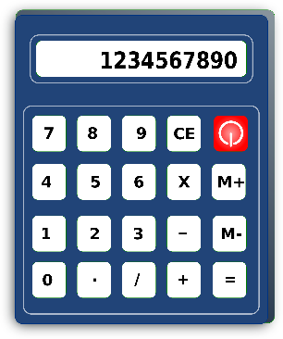
Funding Source Calculations
The General Fund and Read by Grade 3 utilize the District Average rate to calculate position costs
The (editable) funds below utilize the Actual employee salary to calculate position costs:
  HOPE2
  TITLE I
  AT-RISK
  ENGLISH LEARNERS

Slide 6
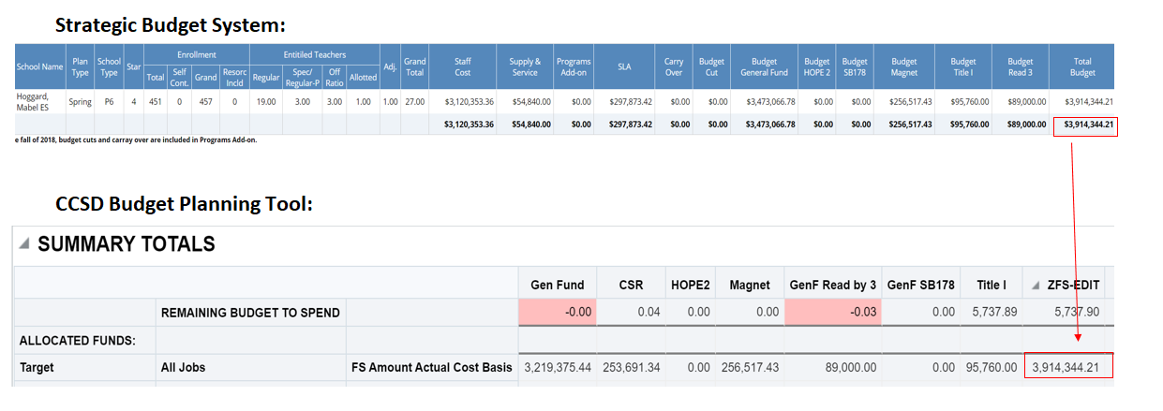
Reconciling Target Dollars
Notes:
Strategicbudget.ccsd.net/admin > Budgeting New > Enter Location & Season > Click on Edit Pencil >Budget Planning New
The first thing you’re looking at is the allocation of dollars. We’re making the transition to the new budget tool in steps. Your allocation was calculated using the old system in the same manner as previous years. We took the total dollars of that calculation and loaded it to the new CCSD Budget Planning Tool target dollars.
The position information gets loaded from the new HCM system. The new HCM system is the HR system of record and what you see is these are the current employees at your location.
To review how your funds got allocated/calculated please refer to your budget summary (as in the past).
Summary Totals: The Summary Totals area contains a running total of each tab available in the School Budget form. This includes Administrative, Licensed, Support, Add’l. Earnings, etc. It provides total dollar amounts by each tab type, and from what funding source they are being taken. Any cells appearing in red delineate a negative balance, which must be reconciled before a budget scenario can be promoted for review and approval.

Slide 7


CCSD Budget Planning Tool Functions:
Access the CCSD Budget Planning Tool through HCM PeopleSoft
Update User Preferences
Access and Edit the School Budget
Student Teacher Ratio Validation (Elementary schools only):
Increase the Headcount of an Existing Position
Add and Adjust Positions
Change the Funding Source of a New Position
Remove a Position
Transfer a Licensed employee to an Existing Position
Transfer a Licensed employee to a New Vacant Position
How to Clear a Transfer – To reinstate a licensed employee transfer to their original position
Budget for a Shared Position
Budget for a Prep Buy Out
Budget for a Certified Teacher Tutor (CTT)
Budget for Support Add-On or Extra Time
Budget for Supplies and Other Services
Export a Tab and Budget Totals
View Employee’s Actual Salary Rate
Print Budget Plans

Slide 8
User Preferences
After accessing the CCSD Budget Planning Tool for the first time (or if you have changed schools), it is necessary to set up your User Preferences so that you are able to access your work location’s budget.
Update Fiscal Year to FY22.
If you manage more than one school budget, select “Funding Source” when updating your user preferences. This will allow you to view funding at your multiple locations.

Slide 9

Deleting a Position
Deleting a position permanently deletes important historical data from the School Budget form
Instead, to remove a position, change the Planned FTE field to “0” for a Licensed/Administrative employee, or change the Hours Per Day field to “0” for a Support Professional employee. This ensures that the position dollars are removed without deleting the record of the position.

Slide 10

Questions
Any questions that cannot be asked or answered during this session can be emailed to 0862-strategic-budget@nv.ccsd.net. Answers will be provided as quickly as possible through return email.

